Slide 1


Introduction to Computer Science
Reichman University
Lecture 9-2
Efficiency, Searching, Sorting
Notes:
1

Slide 2
Lecture plan
Program efficiency
Searching algorithms
Sorting algorithms
Graph algorithms (a taste)

Slide 3
Lecture plan
Program efficiency:
So far in the course we treated it informally and casually...
From now on we’ll treat it formally and seriously.
Two kinds of program efficiency
Time efficiency: How fast is the program?
Space efficiency: How much memory does it consume?

Slide 4
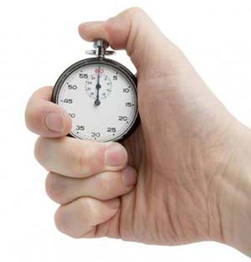

Time efficiency
Two approaches of studying time efficiency
Timing the program
Analyzing the algorithm

Slide 5
Timing program’s efficiency
Timer API (useful tool)
/** Represents a timer.
* Features methods for time measurements. */
public class Timer {
/** Constructs a timer and sets it to the current time. */
public Timer()
/** Resets this timer. */
public void reset()
/** Returns how many milliseconds elapsed between
* the last reset of this timer and the current time. */
public double elapsedTime()
}
// Starts a timer
Timer timer = new Timer();
// Running some mission-critical method we wish to time
contains(arr, x)
// Checking how much time it took
System.out.println("Time to find out: " + timer.elapsedTime());
Client code example: (can appear in any class)

Slide 6
Timing program’s efficiency
/** Times various operations on my computer. */
public class TimeOps{
public static void main(String args[]) {
int sum = 0;
double d = 1.618;
BankAccount bobAcct = new BankAccount("bob");
// Starts a timer
Timer timer = new Timer();
// Runs an operation, a billion times
for (int i = 0; i < 1000000000; i++) {
//// Uncomment the operation you wish to time:
// 1. Do nothing
// 2. sum = sum + i;
// 3. d = 1.0 / d;
// 4. bobAcct.deposit(1000);
// 5. BankAccount b = new BankAccount("Foo");
// 6. Fraction f = new Fraction(i, i + 1);
// 7. d = Math.random();
// 8. System.out.println(i);
}
// The loop’s running time, in milliseconds
System.out.println(timer.elapsedTime());
}
}
Shimon’s old PC (2018)
Shimon’s newer PC (2021)
1. 5 ms
2. 389
3. 4898
4. 57
5. 1089
6. 10500
7. 25310
8. 5510222
2 ms
298
3811
47
1088
4741
21526
5443566

Slide 7
Timing program’s efficiency
Limitations
Any one of the following factors impacts the timing results:
Different hardware
Different OS
Different compiler
And more.
Shimon’s old PC (2018)
Shimon’s newer PC (2021)
1. 5 ms
2. 389
3. 4898
4. 57
5. 1089
6. 10500
7. 25310
8. 5510222
2 ms
298
3811
47
1088
4741
21526
5443566

Slide 8
Timing program’s efficiency
Limitations
Any one of the following factors impacts the timing results:
Different hardware
Different OS
Different compiler
And more.
Needed: A platform-independent way to measure time efficiency.

Slide 9
Time efficiency
Two approaches of studying time efficiency
Timing the program
Analyzing the algorithm

Slide 10
Running time analysis
Example 1: Searching an array of size N
// Checks if the given array contains the given value
boolean contains(int[] arr, int x) {
int N = arr.length;
for (int i = 0; i < N; i++)
if (arr[i] == x)
return true;
return false;
}

Slide 11
Running time analysis
Example 1: Searching an array of size N
How many operations are actually executed during run-time?
Depends on N = input size
// Checks if the given array contains the given value
boolean contains(int[] arr, int x) {
int N = arr.length;
for (int i = 0; i < N; i++)
if (arr[i] == x)
return true;
return false;
}
c0
c1
c2
c3
c4
c5
Identify the program’s operations
c6

Slide 12
Running time analysis
Example 1: Searching an array of size N
How many operations are actually executed during run-time?
Depends on N = input size
// Checks if the given array contains the given value
boolean contains(int[] arr, int x) {
int N = arr.length;
for (int i = 0; i < N; i++)
if (arr[i] == x)
return true;
return false;
}
c0
c1
c2
c3
c4
Running time (in this particular problem)
Best case: x is the first element in the array
Worst case: x is not in the array
Average case: x is somewhere in the array
c5
c6
Our approach to running time analysis
Focus on the worst case
When we say “running time”, we mean running time in the worst case
The most conservative, honest approach.

Slide 13
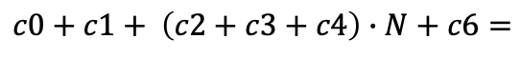
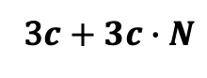
Running time analysis
Example 1: Searching an array of size N
How many operations are actually executed during run-time?
Depends on N = input size
// Checks if the given array contains the given value
boolean contains(int[] arr, int x) {
int N = arr.length;
for (int i = 0; i < N; i++)
if (arr[i] == x)
return true;
return false;
}
c0
c1
c2
c3
RunningTime (N) = (in the worst case)
c4
$$c0+c1+ \left(c2+c3+c4\right)∙N+c6=$$
c5
Assuming that each operation takes more or less the same time, c:
c6
3$c+3c∙N$
(Note: the fact that 3 appears twice in this polynomial is just a coincidence)

Slide 14
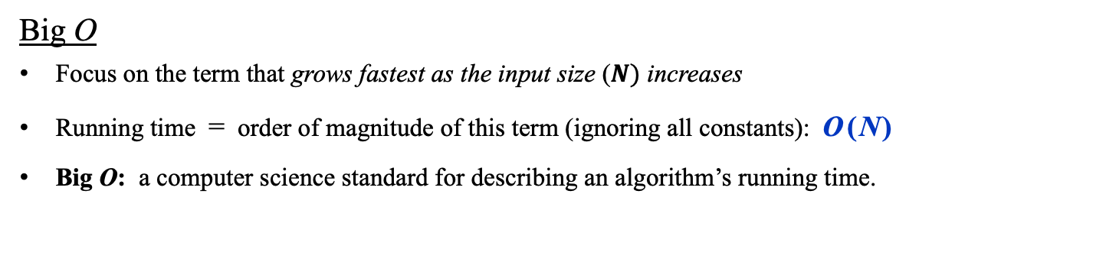
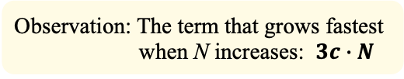
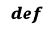
Running time analysis
Example 1: Searching an array of size N
How many operations are actually executed during run-time?
Depends on N = input size
// Checks if the given array contains the given value
boolean contains(int[] arr, int x) {
int N = arr.length;
for (int i = 0; i < N; i++)
if (arr[i] == x)
return true;
return false;
}
c0
c1
c2
c3
RunningTime (N) = (in the worst case)
c4
$$c0+c1+ \left(c2+c3+c4\right)∙N+c6=$$
c5
Assuming that each operation takes more or less the same time, c:
c6
3$c+3c∙N$
Observation: The term that grows fastest when N increases: $3c∙N$
Big O
Focus on the term that grows fastest as the input size ($N)$ increases
Running time = order of magnitude of this term (ignoring all constants): O ( N )
Big O: a computer science standard for describing an algorithm’s running time.
$$def$$

Slide 15
Running time analysis
Example 2: Searching a 2D array of size N by N
// Checks if the given array contains the given value
Boolean contains(int[][] arr, int x) {
int N = arr.length;
for (int i = 0; i < N; i++)
for (int j = 0; j < N; j++)
if (a[i][j] == x)
return true;
return false;
}

Slide 16
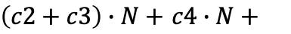
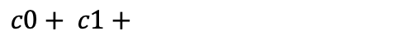
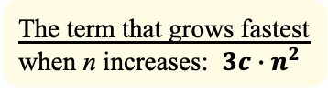
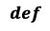
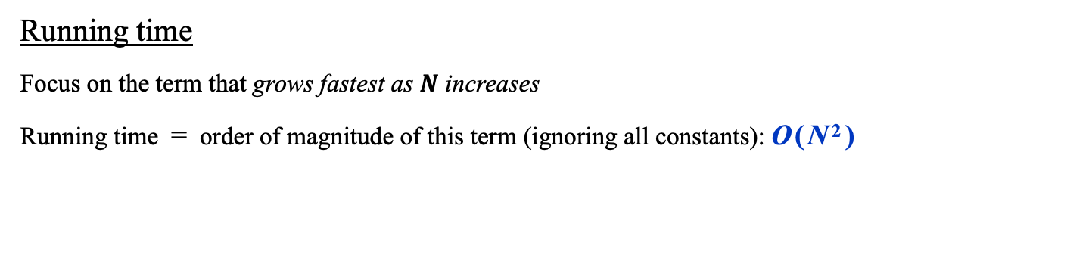
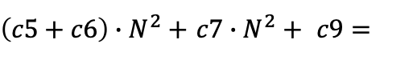
Running time analysis
Example 2: Searching a 2D array of size N by N
// Checks if the given array contains the given value
Boolean contains(int[][] arr, int x) {
int N = arr.length;
for (int i = 0; i < N; i++)
for (int j = 0; j < N; j++)
if (a[i][j] == x)
return true;
return false;
}
RunningTime (N) =
$$c0+ c1+$$
c0
$\left(c2+c3\right)∙N+$ $c4∙N+$
c1
c2
c3
$\left(c5+c6\right)∙N^{2}+$ $c7∙N^{2}+ c9=$
c4
c5
c6
Assuming that each operation takes more or less the same time, c:
c7
c8
$$3c+3c∙n+3c∙N^{2}$$
c9
Assumption: Each operation takes more or less the same time, c
The term that grows fastest when n increases: $3c∙n^{2}$
Running time
Focus on the term that grows fastest as $N$ increases
Running time = order of magnitude of this term (ignoring all constants): O ( N ² )
$$def$$

Slide 17
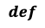
Running time analysis
Example 3: Parity
// Checks the parity of the given number
Boolean isEven(int n) {
return (n % 2) == 0;
}
Running time
Does not depend on the input size (n)
RunningTime (n) = O ( 1 )
$$def$$

Slide 18
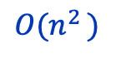
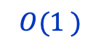
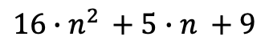

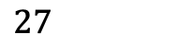
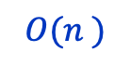
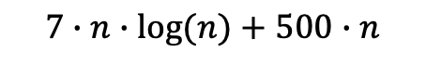
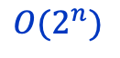

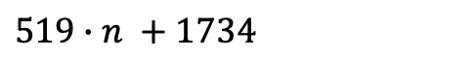
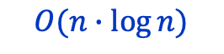
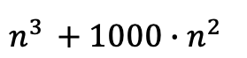
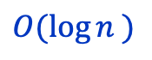
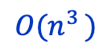
Common running time functions
Examples
$$27$$
$$O(1^{ })$$
$$O(n^{ })$$
$${519∙n}^{ }+1734$$
$${16∙n}^{2 }+{5∙n}^{ }+9$$
$$O(n^{2 })$$
$$n^{3 }+{1000∙n^{2 }}^{ }$$
$$O(n^{3 })$$
n = input size
$$200∙log\left(n\right)+15$$
$$O({\log{n}}^{ })$$
$$7∙n∙log⁡(n)+500∙n$$
$$O(n∙\log{n})$$
$$2∙n^{10}+2^{n}$$
$$O(2^{n})$$

Slide 19
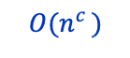
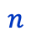
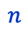
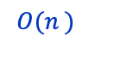
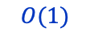
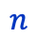
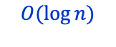
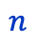
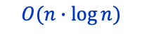
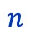
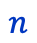
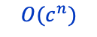
Common running time functions
constant
$$O(n^{c })$$
$$O(1)$$
linear
$$O(n^{ })$$
polynomial
$$n$$
$$n$$
$$n$$
$$O(n∙\log{n})$$
$$O(c^{n})$$
logarithmic
$$O(\log{n})$$
log-linear
exponential
$$n$$
$$n$$
$$n$$

Slide 20
Linear VS constant running time
Removing element i from an ordered array with size = n elements:
2
4
4
6
7
8
8
9
size = 8
The algorithm’s input is an object consisting of three fields: arr, the array itself, maxSize, the fixed length of the array, and size, the number of elements that are presently in the array. Thus the actual input size is size.
In the example above the array is presently full: size = maxSize

Slide 21
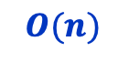
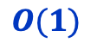
Linear VS constant running time
Removing element i from an ordered array with size = n elements:
Before:
2
4
4
6
7
8
8
9
size = n
After:
2
4
4
7
8
8
9
9
size = n – 1
RunningTime(n) =
Can we do better?
$$O(n)$$
Removing element i from an unordered array with size = n elements:
Before:
4
2
1
7
3
2
5
2
size = n
After:
4
2
1
2
3
3
5
2
size = n – 1
RunningTime(n) =
$$O(1)$$

Slide 22
Lecture plan
Program efficiency
Search algorithms
Sequential search
Binary search
Sorting algorithms
Graph algorithms

Slide 23
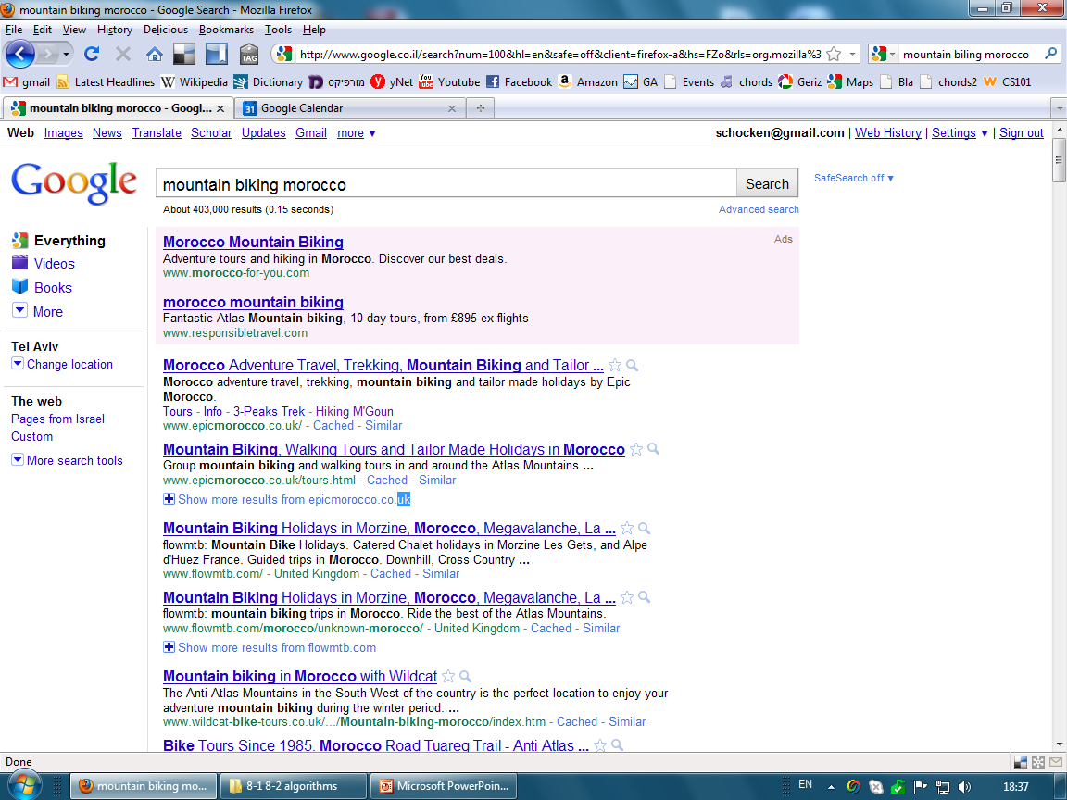

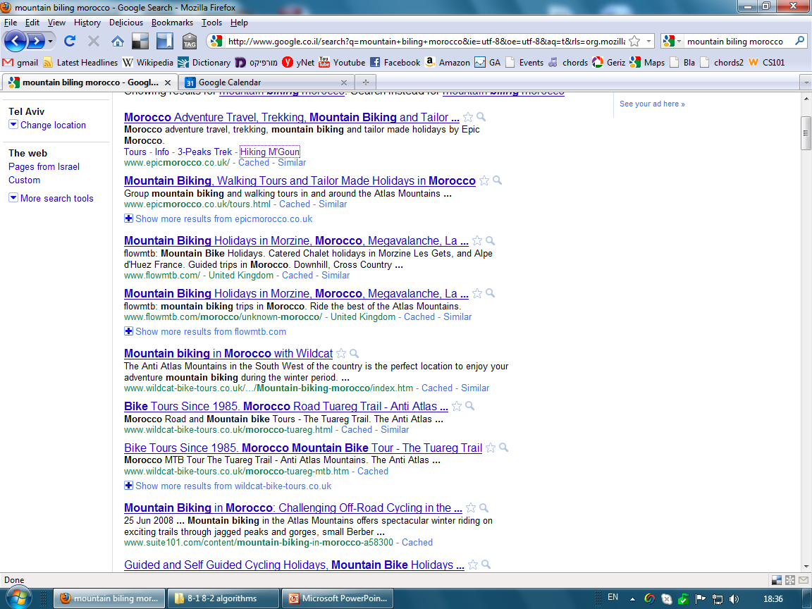

Context example: Search engine

Slide 24
Context example: Search engine
word
URLs
ninex
moize
morgan
namibia
mormon
morning
nancy
morocco
mortal
Mortgage
nalini
mountain
mohican
nader
name
never
nike
nitro
1955, 21
2, 11
13, 100,
95
1 ,7
4, 83
5, 17
12, 4
1, 7, 4, 5
17
5, 17
81, 9
11, 4, 5
10, 3, 5, 4
5, 11, 12,
5, 17
3, 51, 7,
1955, 21
The search engine’s data
A list of words,
each associated with the URLs of web pages that include it;
Stored on many servers and maintained continuously by hard-working robots.
... n words

Slide 25
Context example: Search engine
morocco
search
word
URLs
ninex
moize
morgan
namibia
mormon
morning
nancy
morocco
mortal
Mortgage
nalini
mountain
mohican
nader
name
never
nike
nitro
1955, 21
2, 11
13, 100,
95
1 ,7
4, 83
5, 17
12, 4
1, 7, 4, 5
17
5, 17
81, 9
11, 4, 5
10, 3, 5, 4
5, 11, 12,
5, 17
3, 51, 7,
1955, 21
Typical search scenario
User enters a word
The search engine searches the word in the list
Returns the URL’s, sorted by PageRank
Critical success factors:
Fast searching
Fast sorting.
... n words

Slide 26
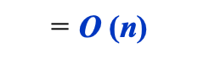
Sequential search
morocco
search
word
URLs
ninex
moize
morgan
namibia
mormon
morning
nancy
morocco
mortal
Mortgage
nalini
mountain
mohican
nader
name
never
nike
nitro
1955, 21
2, 11
13, 100,
95
1 ,7
4, 83
5, 17
12, 4
1, 7, 4, 5
17
5, 17
81, 9
11, 4, 5
10, 3, 5, 4
5, 11, 12,
5, 17
3, 51, 7,
1955, 21
Running time
$$\text{= }\text{O} \text{(}\text{n}\text{)}$$
... n words

Slide 27
Sequential search
// Returns the index of x in arr, or -1 if not found
public static int indexOf(int x, int[] arr) {
for (int i = 1; i < arr.length; i++) {
if (arr[i] == x) {
return i;
}
}
// Value not found
return -1;
}
0
1
1
3
4
5
6
7
8
9
97
51
72
83
20
7
9
15
91
2
arr
Worst case: x is not in arr
(similar to the contains method we saw earlier)
Running time
$$\text{= }\text{O} \text{(}\text{n}\text{)}$$
Can we do better?

Slide 28
Binary search
morocco
search
word
URLs
mohican
moize
morgan
mormon
morning
morocco
mortal
mortgage
mountain
nader
nalini
name
namibia
nancy
never
nike
ninex
nitro
11, 4, 5
2, 11
13, 100,
1 ,7
4, 83
12, 4
1, 7, 4, 5
17
81, 9
10, 3, 5, 4
9
5, 11, 12,
95
17, 2, 8
5, 17
3, 51, 7,
9, 1
1955, 21
The data is sorted
... n words

Slide 29
Binary search
morocco
search
word
URLs
mohican
moize
morgan
mormon
morning
morocco
mortal
mortgage
mountain
nader
nalini
name
namibia
nancy
never
nike
ninex
nitro
11, 4, 5
2, 11
13, 100,
1 ,7
4, 83
12, 4
1, 7, 4, 5
17
81, 9
10, 3, 5, 4
9
5, 11, 12,
95
17, 2, 8
5, 17
3, 51, 7,
9, 1
1955, 21
?
“morocco” <= “mountain”
1
The data is sorted
... n words

Slide 30
Binary search
morocco
search
word
URLs
mohican
moize
morgan
mormon
morning
morocco
mortal
mortgage
mountain
nader
nalini
name
namibia
nancy
never
nike
ninex
nitro
11, 4, 5
2, 11
13, 100,
1 ,7
4, 83
12, 4
1, 7, 4, 5
17
81, 9
10, 3, 5, 4
9
5, 11, 12,
95
17, 2, 8
5, 17
3, 51, 7,
9, 1
1955, 21
?
“morocco” <= “mormon”
2
?
“morocco” <= “mountain”
1
The data is sorted
... n words

Slide 31
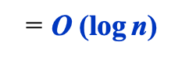
Binary search
morocco
search
word
URLs
mohican
moize
morgan
mormon
morning
morocco
mortal
mortgage
mountain
nader
nalini
name
namibia
nancy
never
nike
ninex
nitro
11, 4, 5
2, 11
13, 100,
1 ,7
4, 83
12, 4
1, 7, 4, 5
17
81, 9
10, 3, 5, 4
9
5, 11, 12,
95
17, 2, 8
5, 17
3, 51, 7,
9, 1
1955, 21
?
“morocco” <= “mormon”
2
?
“morocco” <= “morocco”
3
?
“morocco” <= “mountain”
1
In each iteration we divide the size of the search space by 2
How many times can we divide n by 2?
Running time
$$\text{= }\text{O} \text{(}\text{log} \text{n}\text{)}$$
The data is sorted
... n words

Slide 32
Binary search
// Returns the index of x in a sorted arr, or -1 if not found
// Precondition: arr must be sorted
public static int indexOf(int x, int[] arr) {
0
1
1
3
4
5
6
7
8
9
2
7
9
15
20
51
72
83
91
97
arr
Running time
$$\text{= }\text{O} \text{(}\text{log} \text{n}\text{)}$$

Slide 33
Binary search
// Returns the index of x in a sorted arr, or -1 if not found
// Precondition: arr must be sorted
public static int indexOf(int x, int[] arr) {
int low = 0;
int high = arr.length - 1;
while (low <= high) {
int med = (low + high) / 2;
if (arr[med] == x) {
return med;
}
if (x < arr[med]) {
high = med - 1;
} else {
low = med + 1;
}
}
// Value not found
return -1;
}
0
1
1
3
4
5
6
7
8
9
2
7
9
15
20
51
72
83
91
97
arr
Simulating indexOf(72, arr):
Iteration low high med arr[med] test
0 0 9 4 20 72 > 20 ?
1 5 9 7 83 72 < 83 ?
2 5 6 5 51 72 > 51 ?
3 6 6 6 72 72 = 72
Running time
$$\text{= }\text{O} \text{(}\text{log} \text{n}\text{)}$$

Slide 34
Binary vs sequential search
Seq. Binary
search search
running tine (worst case)
n
O(n)
O(log₂n)
O(n)
Input size:
RunningTime
8
8
3
16
16
4
sequential search
32
32
5
64
64
6
100
100
7
O(log n)
1,000
1,000
10
binary search
1,000,000
1,000,000
20
1,000,000,000
1,000,000,000
30
input size: n
Why is logarithmic running time attractive? Because log₂(2n) = log₂n + 1
Implications for search engines:
As the size of the Internet doubles, each search requires one more iteration.

Slide 35
Lecture plan
Program efficiency
Search algorithms
Sequential search
Binary search
Sorting algorithms
Selection sort
Insertion sort
Radix sort
Graph algorithms

Slide 36
Sorting
Before:
13
10
7
3
15
1
4
11
After in-place sorting:
After:
1
3
4
7
10
11
13
15
There are many sorting algorithms, of which we’ll discuss three.

Slide 37
Selection sort
Analysis
step 0: we scan n elements
step 1: we scan n – 1 elements
step 2: we scan n – 2 elements
...
Total number of iterations =
n + (n – 1) + … + 1 = ½ n(n – 1) = ½ n² - ½ n
Running time = O (n²)
// Sorts an array of length n
for i = 0 .. n – 1
min = i
for k = i + 1 .. N
if (a[k] < a[min])
min = k
swap a[i], a[min]
(informal pseudo-code)
step 0:
13
10
7
3
15
1
4
11
Selection algorithm:
Find the minimum, swap with the next left-most element
step 1:
1
10
7
3
15
13
4
11
step 2:
1
3
7
10
15
13
4
11
step 3:
1
3
4
10
15
13
7
11
...
1
3
4
7
15
13
10
11

Slide 38
Insertion sort
// Sorts array of length n
for j = 1 .. n – 1
k = j – 1
while (a[k] > a[j] and k >= 0)
swap a[k + 1], a[k]
k--
Analysis
How many swaps we have to do in the worst case?
1 + 2 + 3 + … + n = ½ n(n + 1)
Running time = O (n²)
step 0:
10
2
14
5
4
18
3
7
Insertion algorithm:
Going from left to right:
For each element, swap with the element on the left, until the element reaches its place
step 1:
2
10
14
5
4
18
3
7
step 2:
2
10
14
5
4
18
3
7
step 3:
2
5
10
14
4
18
3
7
...
2
4
5
10
14
18
3
7

Slide 39
Simple sort algorithms
Selection sort
Insertion sort
Bubble sort
...
There are many similar sorting algorithms, all based on pairwise comparisons
All O (n²) . . .
Can we do better?

Slide 40
Radix sort
Input: 230, 34, 76, 80, 735, 21, 4, 59
Set up: Create an array of 10 empty lists, one for each digit:
0: ( )
1: ( )
2: ( )
3: ( )
4: ( )
5: ( )
6: ( )
7: ( )
8: ( )
9: ( )

Slide 41
Radix sort
Input: 230, 34, 76, 80, 735, 21, 4, 59
Step 0: Add the values to the lists, according to their least significant (right-most) digit:
230, 34, 76, 80, 735, 21, 4, 59
0: (230, 80)
1: (21)
2: ( )
3: ( )
4: (34, 4)
5: (735)
6: (76)
7: ( )
8: ( )
9: (59)
Remove the values from the lists, preserving their order:
Output: 230, 80, 21, 34, 4, 735, 76, 59

Slide 42
Radix sort
Input: 230, 80, 21, 34, 4, 735, 76, 59
(Output of previous stage)
0: ( )
1: ( )
2: ( )
3: ( )
4: ( )
5: ( )
6: ( )
7: ( )
8: ( )
9: ( )

Slide 43
Radix sort
Input: 230, 80, 21, 34, 4, 735, 76, 59
(Output of previous stage)
Step 1: Add the values to the lists, according to their next right-most digit:
230, 080, 021, 034, 004, 735, 076, 059
0: (4)
1: ( )
2: (21)
3: (230, 34, 735)
4: ( )
5: (59)
6: ( )
7: (76)
8: (80)
9: ( )
Remove the values from the lists, preserving their order:
Output: 4, 21, 230, 34, 735, 59, 76, 80

Slide 44
Radix sort
Input: 4, 21, 230, 34, 735, 59, 76, 80
(Output of previous stage)
0: ( )
1: ( )
2: ( )
3: ( )
4: ( )
5: ( )
6: ( )
7: ( )
8: ( )
9: ( )

Slide 45
Radix sort
Input: 4, 21, 230, 34, 735, 59, 76, 80
(Output of previous stage)
Step 2: Add the values to the lists, according to their next right-most digit:
004, 021, 230, 034, 735, 059, 076, 080
0: (4, 21, 34, 59, 76, 80)
1: ( )
2: (230)
3: ( )
4: ( )
5: ( )
6: ( )
7: (735)
8: ( )
9: ( )
Time complexity:
RunningTime = O (k N)
where k is the number of digits of the maximal value
Space complexity:
Storing the 10 lists
Remove the values from the lists, preserving their order:
Output: 4, 21, 34, 59, 76, 80, 230, 735
sorted

Slide 46
Lecture plan
Program efficiency
Search algorithms
Sequential search
Binary search
Sorting algorithms
Selection sort
Insertion sort
Radix sort
Graph algorithms (a taste)

Slide 47
Graph algorithms
node
edge
Input size: N nodes
Euler path: Is there a path that visits every edge exactly once?
There is a simple algorithm that answers this question in linear time: O (N)
Hamilton path: Is there a path that visits every node exactly once?
So far, the only algorithms that answer this question run in exponential time: O (2^{N} )
RUNI’s Algorithms course focus: Graph Theory

Slide 48
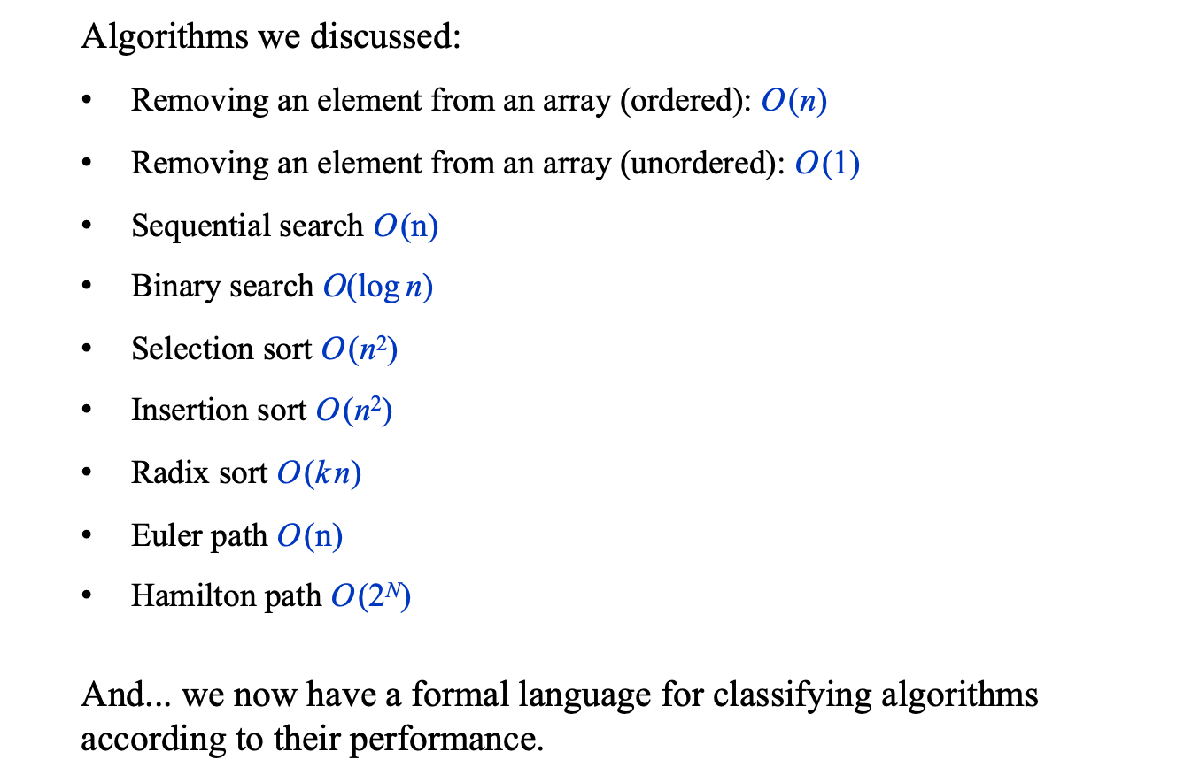
Recap
Algorithms we discussed:
Removing an element from an array (ordered): O (n)
Removing an element from an array (unordered): O (1)
Sequential search O (n)
Binary search $\text{O}\text{(}\text{log} \text{n}\text{)}$
Selection sort O (n²)
Insertion sort O (n²)
Radix sort O (k n)
Euler path O (n)
Hamilton path O (2^{N})
And... we now have a formal language for classifying algorithms according to their performance.

Slide 49
Common running time functions
simple sorting algorithms
Hamilton path
QuickSort,
MergeSort
sequential search
Radix sort
Euler path
Input size (N)
Binary search

Slide 50
Appendix: The Timer class
/** Represents a timer.
* Features methods for time measurements. */
public class Timer {
// The time at which this timer started running
private long startTime;
/** Constructs a timer and sets it to the current time. */
public Timer() {
reset();
}
/** Resets this timer. */
public void reset() {
startTime = System.currentTimeMillis();
}
/** Returns how many milliseconds elapsed between
* the last reset of this timer and the current time. */
public double elapsedTime() {
return (System.currentTimeMillis() – startTime);
}
}
A Java function, returns the time difference, in milliseconds, between 00:00, 1/1/1970,
and the current time.

